Slide 1

Testing code
Mocks

Slide 2
Objectives
In this chapter you'll learn about creating and using mocks

Slide 3
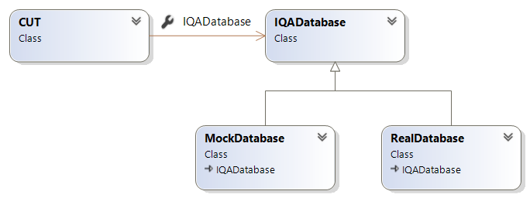
What is Mock?
Used when your class has dependency
Dependency created by a mocking framework to provide the same functionality
Provides the same functionality as a Stub but Stubs are often easier to create
interface

Slide 4


Creating mocks with Java

Slide 5
Using Mochito with Java
Mockito is a useful app to mock external dependencies.
To use Mochito, you need to set it up. Here is a POM file example
<dependencies>
<dependency>
<groupId>junit</groupId>
<artifactId>junit</artifactId>
<version>4.12</version>
<scope>test</scope>
</dependency>
<dependency>
<groupId>org.mockito</groupId>
<artifactId>mockito-core</artifactId>
<version>4.1.0</version>
<scope>test</scope>
</dependency>
</dependencies>

Slide 6
Mockito - Setting expectations
Creates an interface for a dependency in your Unit tests
Set up your method's expected values
So, how do we get Mochito to do all these? Let's see…

Slide 7
Mocking an object using Mockito
public class QADatabase {
public Product getProduct(int id){
// complex operation to get the product from a real database
}
}
Object to mock
public class QATest {
QADatabase db;
@BeforeEach
public void setUp() {
db = Mockito.mock(QADatabase.class);
Mockito.when(db.getProduct(10)).thenReturn(new Product(10,"Pen",50)); Mockito.when(db.getProduct(80)).thenReturn(new Product(80,"Ruler",1.20));
Mockito.when(db.getProduct(99)).thenReturn(new Product(99,"Paper",30.0));
}
}

Slide 8
Mokito Exceptions
public class QATest {
Account acc;
@BeforeEach
public void setup() throws IllegalArgumentException
{
acc = Mockito.mock(Account.class);
Mockito.when(acc.withdraw(200.0)).thenThrow(IllegalArgumentException.class);
}
@Test(expected = IllegalArgumentException.class)
public void testAccount_WithdrawingInsufficientFundsThrows_IllegalArgumentException()
{
// many lines of code leading to x = 200;
acc.withdraw(x);
}
}

Slide 9
Mokito Exceptions + parameter ranges
public class QATest {
private IQA_Database db;
@BeforeEach
public void setup() {
db = mock(IQA_Database.class);
when(db.getProduct(eq(0))).thenThrow(new IllegalArgumentException());
when(db.getProduct(intThat(n -> n< 0))).thenThrow(new IllegalArgumentException());
when(db.getProduct(intThat(n -> n > 100))).thenThrow(new IllegalArgumentException());
// Return Product for 1–100
when(db.getProduct(intThat(n -> n >= 1 && n <= 100)))
.thenAnswer(invocation -> {
int id = invocation.getArgument(0);
return new Product(id, "Pen", 1);
});
}
Notes:
Note: eq(0) instead of just 0 (zero) works because if other arguments were present, you would match them too. You could use a matcher like anyInt() or isThat(…) for one argument, then all other arguments must also use matchers even if they’re fixed values.

Slide 10
Mochito Verify
public interface EmailService {
void sendEmail(String recipient, String subject, String body);
}
public class OrderProcessor {
private EmailService emailService;
public OrderProcessor(EmailService emailService) {
this.emailService = emailService;
}
public void processOrder(String customerEmail, double price) {
// Order processing logic...
// Send confirmation email
if(price > 100)
emailService.sendEmail(customerEmail, "Confirmation", "Order processed.");
}
}

Slide 11
Mochito - Verify
@Test
void processOrder_ShouldCall_SendEmail()
{
// Arrange
EmailService mockEmailService = Mockito.mock(EmailService.class);
OrderProcessor orderProcessor = new OrderProcessor(mockEmailService);
// Act
orderProcessor.processOrder("Bob@QA.com", 200);
// Assert
verify(mockEmailService, times(1)) // times(0) or never() if not called
.sendEmail("Bob@QA.com", "Confirmation", "Order processed.");
}
Notes:
Use anyString( ) method if any String parameter will do
Use anyDouble( ), anyInt( ) for numeric values.

Slide 12
Lab
Exercise
Please see your Exercise Guide
Mocking framework
Notes:
Please see your Exercise Guide for full instructions.
Work individually or in pairs; your choice.
The exercise should take about 20 minutes.
Solutions are provided in the Exercise Guide for reference.

